Slide 1
“A mechanism of long life emission of meteor persistent trails” Nagatoshi Nogami : IMO Shinsuke Abe: Nihon univ. Department of Aerospace Engineering 2024.21 Sep. IMC Kutná hora

Slide 2
〇What is “Persistent trail”?
It is the long life after glow of a meteor path.
A meteor emits a light of air components’ plasma heated by
its’ ablation shock wave.
The spectrum of a meteor trail often indicates considering its
component metals.
Most of their life time are a few seconds at longest.
But some glow longer time, and for a few ten minutes long.

Slide 3
〇Characteristics of meteor persistent trails
Emission altitude : From 90km to 80km
Duration time : More than 30 seconds
Exponentially decreasing of light intensity
Spectrum : Molecular bands of
metal oxides, sulfids, cyanide…
↓
Proposed light emission mechanism so far
By any chemical reactions of atmospheric components’
chemical reactions or metals from meteoroids’ ones and air?
But,
None of them can give any answer to the long life question!

Slide 4
Emission life time of meteorite trail
Life time of exited atoms and molecules from air
molecules emission reaction reaction rate L. T. in air
O2(1⊿g) O2(1⊿g) +O2 → 2O2 2E-18[cm/s] 0.1[s]
O2(1∑+g) O2(1∑+g) +N2 → O2 + N2 2E-17 0.01
N2(A3∑+u) N2(A3∑+u) +O2 → N2 + O2 4E-12 5E-8
O(1D) O(1D) + O2 → O + O2 5E-11 4E-9
O(1S) O(1S) + O2 → O + O2 3E-13 5E-7
vibrational exited molecule
N2* N2* + N2 → N2 + N2 1E-19
N2* + CO2 → N2 + CO2 6E-15 0.02
O2* O2* + O2 → 2O2 1E-17 0.02
B.M. Smirnov : Exited Atoms and Molecules (Wiley, New York, ‘87)
D.J.Miller et al. : CLEO ’82, paper NFS 2 ‘82

Slide 5
Chemical species generated by meteoroid ablation
〇Chemical species identified by observed spectrum
Metals ：Fe Na、Mｇ、Ca、 ・・・
Metal oxides ：FeO、NaO、MgO、CaO、TiO、・・・
Non-metals ：O2、OH、CN、・・・
They are generated as meteoroid minerals’ vapor (plasma) by high temperature ablation heat.
→ Vaporizing behavior of metal oxides

Slide 6
Analysis of radiation life time factor
/ Life time of chemical reaction of gas spices are very short
in order of around micro- or less than milli-seconds.
--- Aren’t they atom or molecule (ions)?
/ Their trail keeps its tube like shape with twisting
behavior by winds at upper altitude.
--- They don’t disperse soon like gas.
--- Their trail look like smoke.
???

Slide 7
Analysis of radiation life time factor
/ Life time of chemical reaction of gas spices are very short
in order of around micro- or less than milli-seconds.
--- Aren’t they atom or molecule (ions)?
/ Their trail keeps its tube like shape with twisting
behavior by winds at upper altitude.
--- They don’t disperse soon like gas.
--- Their trail look like smoke.
They must be condensed phase, micro cluster or dust.

Slide 8
Condensed phase generation at meteoroid ablation
1. Condensation , recrystallization of vapor chemical spices from the meteoroid.
: Nanotechnology produces sub-μm particles in vacuum
2. Slipping off and separation of non-melt mineral grains from meteoroid’s surface by ablation heat.
: Loosely agglomerating grains
--- A kind of fractal structure : exp.; cosmic dust
“Dust plasma by meteor radar echoes” by M.C.Kelly (2004)

Slide 9
Light emission from small solid particles
/ Is it by their black body?
No, they cannot emit light at low tempera-
ture like around 300K*.
300K* : From “IR spectroscopy of persistent Leonids trains”
by R.W. Russell, G.S. Rossano, M.R. Chatelain, et al., 2001
/ Then by a kind of luminessence?
Yes, they works at such low temperature,
and the lower temperature the longer
emission lifetime.

Slide 10
Luminescence and fluorescence
Heat Heat
Electomagnetic field Photon
Sound Electron /Ion
Mechanical force Chemical reacion
Chemicals products
An electron transfers from the ground state to the exited state by getting the energy from outside.
The emission of a luminescence photon takes place when an exited electron returns to its ground state.
Photon is one of energy emission form of to the g-state transition.
The heat of ablation can make electrons jump to exited states.
Materials

Slide 11
Condensed state and photon emission
Energy transitions involved in the production of a) fluorescence and b) phosphorescence. a), b) for gas components. C.c. model for soloids.
e
m
g E
a) b) g e
The electron energy with B C
configurational coodinate for exited
and ground states in a insulator.
D
0 A
configurational coordinate
Notes:
For exicted and

Slide 12
Light emission from atoms or molucules and solids
By atoms or molecules
Electron transition between different orbital
potentials in a atom/molecule.
By solids
Charge unbalanced electron transition between
energy potentials of regular and defect crystal latice.

Slide 13
Thermoluminescence of meteoroid grains
Photon
Heat Photon
The heat of ablation can make electrons jump to exited states.
Exited electron searches a hole, positive charged, to neutralize
and take place the ground state.
⇒ Meteoroid grains are considered originally contain defects
in their crystal structure.
What kind of defects?
grain

Slide 14
Configurational coodination model
Energy transitions of in a (insulator) crystal with defect. Excess (charge) isolated electron is trapped defect site in the crystal lattice and interaction between it and crystal lattice takes emission.
E
Exited state
${C∗}^{2}$/2γ
C*: deformation potential
constant
γ : bulk modulus
E0*
Ground state
0 C*/$\sqrt{γ}$
configurational coordinate
Notes:
For exicted and

Slide 15
Defects and thermoluminescence
Dangling (non bridging) oxygen bonds formed by introduction of impurities like alkali ion M+ into the SiO2 lattice, the Al-alkali center. : O : Si : Si4+ : M+ :Al
:Si
:
+
O

Slide 16
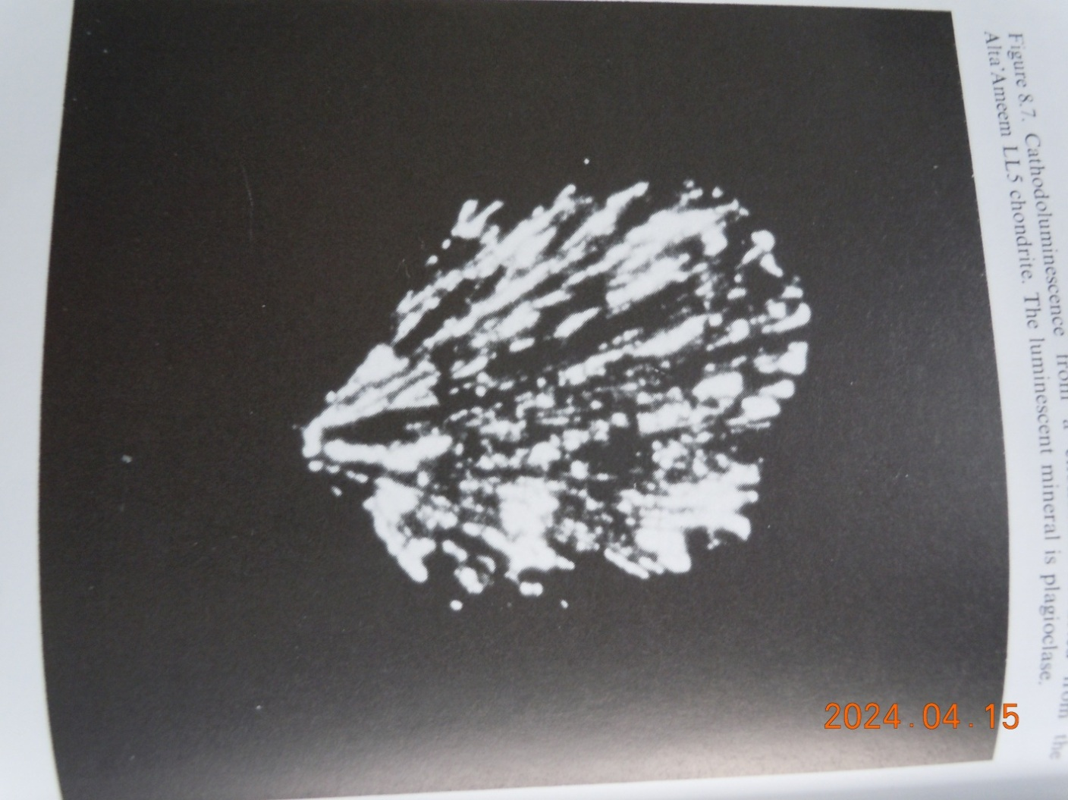
Luminescence of a chondrule
A chondrule extracted from the Alta’AmeemLL5 chondrite. The luminescent mineral is plagioclase. Plagioclase = anorthite: Ca(Si2Al2)O8/ albite : Na(Si3Al)O8 S. McKeever : Thermoluminescence of solids Cambridge Univ. Press ‘85

Slide 17
Conclusion
We propose a long life light emission mechanism of meteor persistent trains comes from thermoluminescence of meteoroid’s dust.
These dusts are generated by the ablation of the meteoroid’s body with appearance and movement like smoke along the meteor path.
Thermoluminescence of (solid) insulator can explain long life light emission, much more than a few minutes, and at lower temperature emission.
Their light emission takes interaction between localized electron and lattice defect in the dust crystal.

